Slide 1

CAREER SERVICES
IRONHACK | SPAIN

Slide 2



/Stage 2.2
Hello Ironhacker!
First of all, congratulations in completing your bootcamp and career week. Now your ready to find your new job.
This guide will be your bible during the next days. Here you are going to find what's next in your job hunt, things you have to get done, and the different activities you'll have access to in order for you to master your job hunt as a tech pro. Also, a checklist at the end to no forget the must haves for the job hunt.
Happy hunting and remember to keep in touch with your coach! 🚀

Slide 3
/Stage 2.2
INDEX:
Job search follow up:
Career Score
Career Coach
Job search support:
Fast Track Interviews
Meet Our Partners
Career Score Opportunities
Share to shine
Boost your job search program
Ask the CTO
Pitch & Go

Slide 4
First Steps
Job Search Follow Up
Career Score
Career Coach
Open your account with the link your Career Coach has provided.
Upload your applications Weekly
We consider “Active job seekers” the students who apply AT LEAST to 10 job offers per week.
This platform will be used to see your advances and blockers.
Remember to maintain contact with your coach.
Keep him/her updated about your job search situation.
Work with him/her any blocker you may have.
Communication channels: Email, slack (urgent matters) and 1:1 (blockers)

Slide 5
Job Search Support
Job Opportunities from Ironhack
As you already know, our Partners Team works everyday to bring new hiring partners and opportunities to our students. How do we share them with you?
Fast Track Interviews
Career Score Opportunities
Register first with this FORM
Make sure your read THIS policies to fully understand the service.
This positions are related to the field you specialized in Ironhack.
You will receive this offers via Email - check SPAM also!
You will have 24hrs to answer sending your CV.
You may receive sometimes offers through this channel in two cases:
Internships
Other Opportunities related to different technologies or specific backgrounds e.g.:
Graphic Design
Data (Excel)

Slide 6
Job Search Support/Events
Share to shine
Looking for a job alone is difficult and we feel you. That is why we have created this biweekly sessions in which you are going to share with other ironhackers your blockers, but also your best tricks.
The session will be practical and the main goal is to reach for solutions between the different participants. You can learn a lot from each other!
To be able to participate you will have to be active in Career Score, have your CV, LinkedIn, Github and portfolio updated and be active with your Career Coach by replaying.

Slide 7
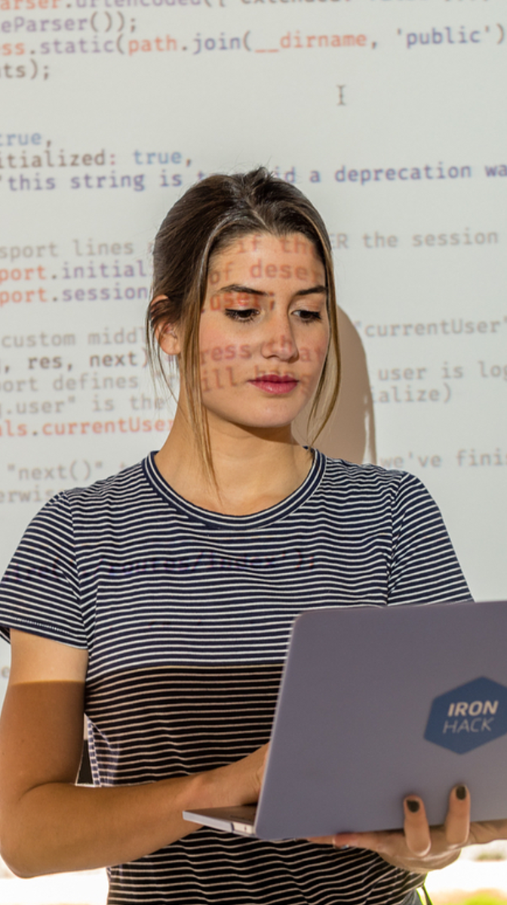
Job Search Support
Boost your job search program
Every 20 days you’ll have talks with amazing professionals from the tech arena to help you refine your job hunt. Professionals from HR and tech profiles, who are going to take your search to the next level.
You’ll receive communications from Ironhack staff inviting you to this event!

Slide 8
Job Search Support
Pitch & Go
Pitching correctly for a recruitment process is super important and can give you direct access to the process. That’s why, having your pitch worked like the greatest seller is mandatory for this new path.
For you to master you pitch, we have created Pitch & Go event; a speed up meeting with recruiters from the IT sector and Ironhack, in which you are going to put in practice your pitch and receive feedback from the best recruiters in town.
For this event, you’ll receive a mail from your coach.

Slide 9
Job Search Support
Meet Our Partners
Exclusive meetups with companies? Yes!
At Ironhack we have lots of partners who believe our alumni are the best fit for their entry and junior positions. This is why we organize meetings between you and the companies, when they have open vacancies that meet your profiles. In some occasions you will even have the opportunity to visit their offices.
You will be able to meet recruiters and hiring managers that will explain not only their recruitment process but also the company values and their way of working.

